Slide 1
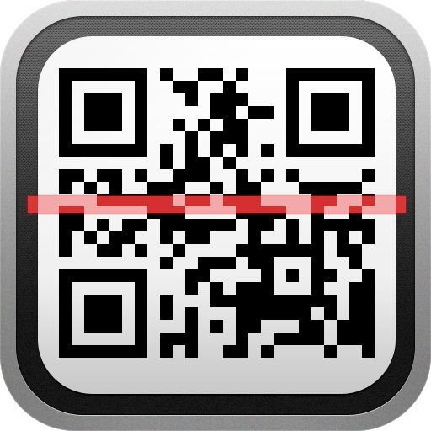
KNOW IT READER
Nanda Gundapaneni

Slide 2
OVERVIEW
Why Know It?
How it works?
Database design
Demo
Future Work

Slide 3
WHY KNOW IT?
Giving user information about the places he/she is visiting
People new to a place will find it useful
Up to date content
Ease of use.

Slide 4
How it works?
QR Code Scanner
Web Services
Authoring tool
Databases

Slide 5
QR CODE
A QR code (abbreviated from Quick Response code) is a type of matrix barcode( 2-D code) first designed for Automotive Industry
Created by Toyota subsidiary Denso Wave in 1994
Any kind of data can be encoded into the QR Code

Slide 6
Authoring tool
Developed on PHP
Populating location data like history and media into the database

Slide 7
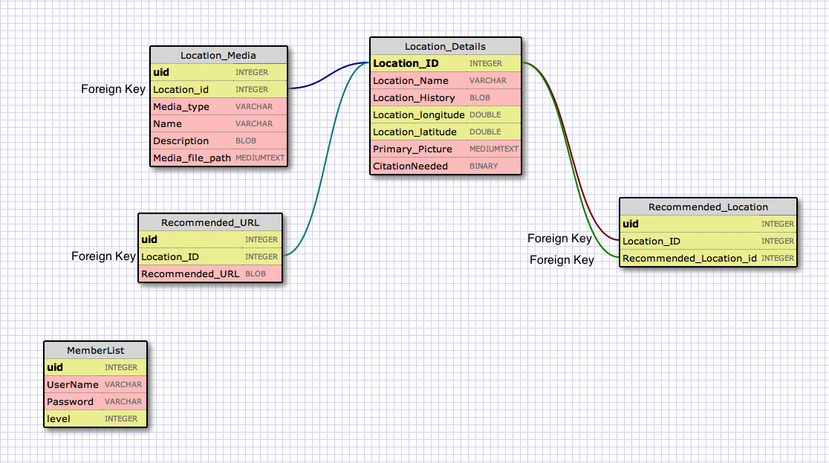
Databases (External)

Slide 8
Web services
Generate XML scripts

Slide 9
Know It app
QR Code Scanner
XML Parser
Internal Database

Slide 10
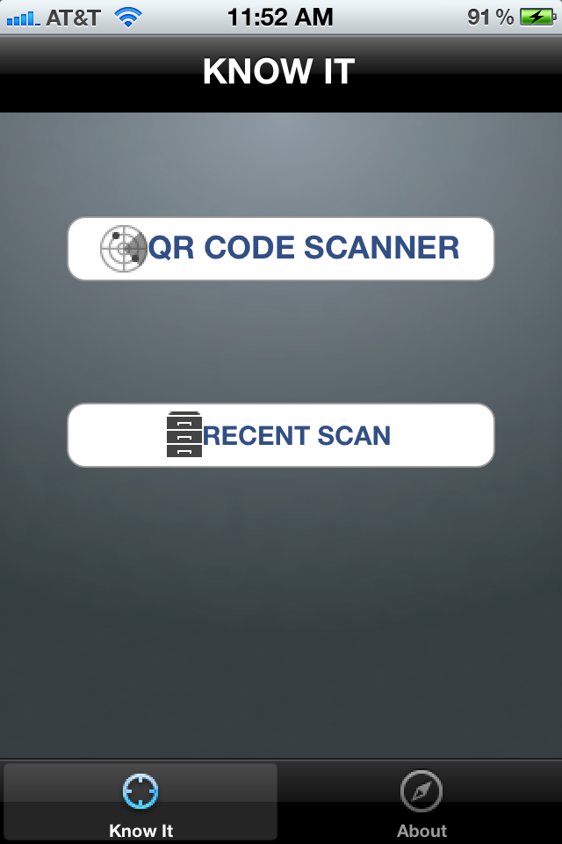
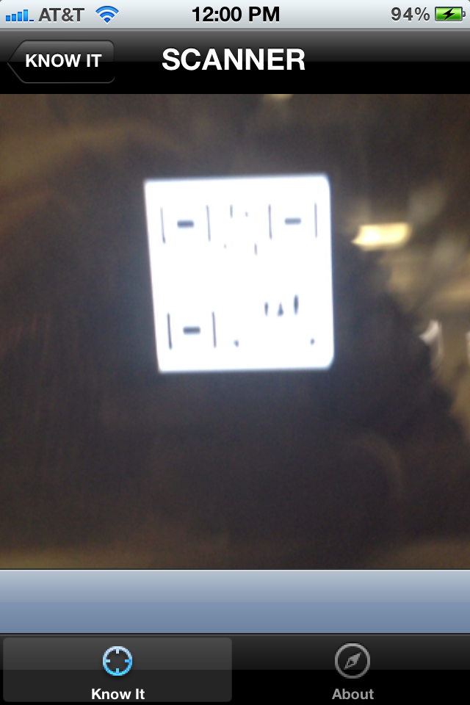
Know it app(contd.)

Slide 11
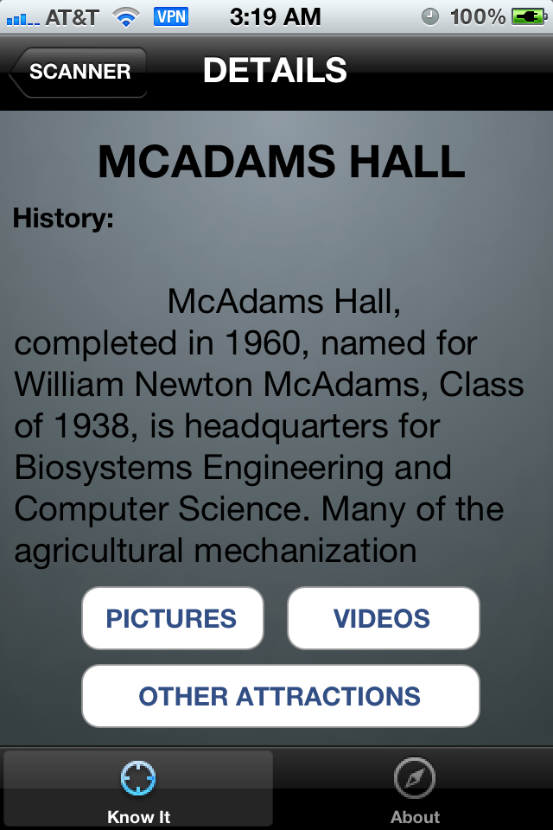
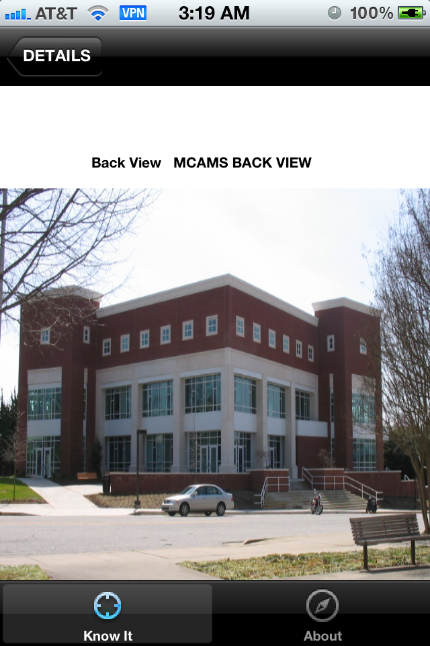
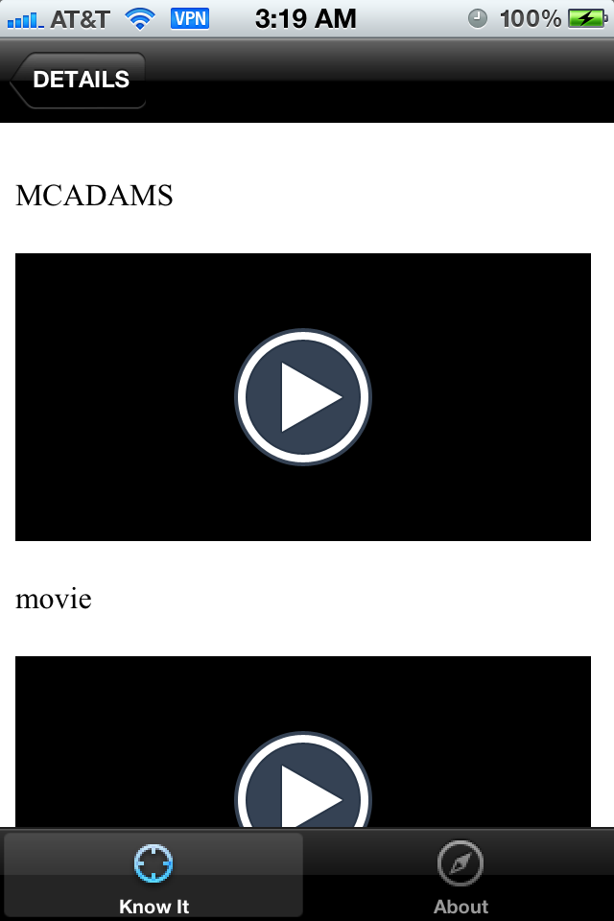
Know it app(contd.)

Slide 12
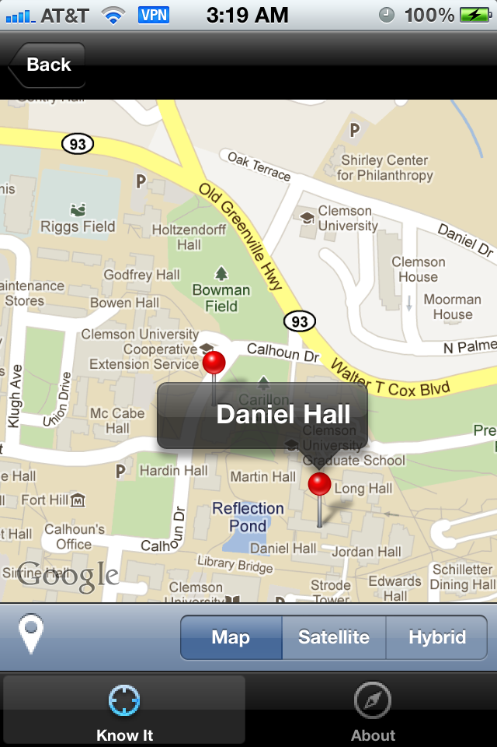
Know it app(contd.)

Slide 13
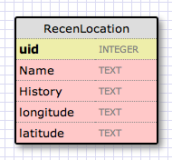
Databases (Internal)

Slide 14
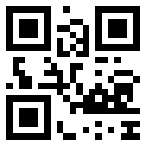
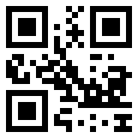
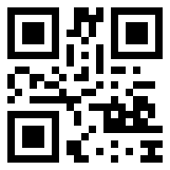
DEMONSTRATION
Authoring Tool
Know it app

Slide 15
ACKNOWLEDGEMENTS
DJ Edmonson
Akash Mudubagilu
Nick Watts

Slide 16
Conclusion
Completed all functionalities
The app is easy to use.

Slide 17
Future Work
Using Google places in the app
Content management using the app
Show best routes to users to the recommended places

Slide 18
QUESTIONS?

